Slide 1
Sentiment Analysis Of Social Media Texts In Using Transformers
g]kfnL
A Dissertation Report
By Regan Maharjan
Roll no. 17/75
Notes:
Supervisor: Assistant Professor Bikash Balami

Slide 2
OUTLINE
Introduction: Sentiment Analysis and Nepali Language trends
The Objective & Limitation of the Study
Background and Literature Review
Research Methodology
Implementation
Result Analysis
Conclusion and Future Recommendation
Notes:
Introduction:
about sentiment analysis
importance of sentiment analysis
trend of Nepali language on social media
transformer model for sentiment analysis
Objective of study – what has been tried to achieve by this study
Model background and Nepali sentiment analysis literature review
Research Methodology – How the research was conducted
Result Analysis – comparative analysis of all the experiments conducted

Slide 3
Sentiment Analysis (SA)
Sentiment Analysis (SA) is the task of identifying and extracting the polarity (positive, negative, and neutral) or emotion and subjective opinions in natural language texts.
SA helps in understanding public opinions and sentiments expressed on digital platforms including social media platforms.

Slide 4
Why Sentiment Analysis of social media texts in g]kfnL?
Social Media platforms have become ubiquitous with the growing usage of smartphones and the availability of the internet.
A growing number of people, businesses, and organizations prefer the Devanagari script as the language of communication on social media platforms. Just on Twitter, more than 20,000 tweets are made, in a day, in Devanagari (code-mixed).
Notes:
Many aspects of our lives are affected by the social media platforms. Our interests, our thoughts, etc. are one way or another being shaped by what we witness on these platforms.
It has become more and more a difficult task to differentiate what is good and what is bad in the vast pool of information available on digital social media platforms. In such a case, sentiment analysis of the information or texts being generated on social media platforms becomes more a necessity than a luxury

Slide 5
Why Transformer?
In recent years, transformer architecture has revolutionized the field of Natural Language Processing (NLP).
They can capture long-range dependencies (context) and learn contextual representations of words and sentences, which had been a bottleneck with RNNs as they couldn’t carry along long-range dependencies.
The top 10 models in the General Language Understanding Evaluation (GLUE) benchmark leaderboard are Transformer based models.
However, very few transformer models are available that are trained on Nepali text datasets, thus lacking support and tools for the sentiment analysis of Nepali texts.

Slide 6
Objectives of the Study
To compare and evaluate different transformer-based auto-encoder models (BERT, distilBERT [13]) and auto-regressive models (GPT2, distilGPT2) on the available datasets (NepCov19Tweets) for Sentiment Analysis in the Nepali language (Devanagari Script).
To investigate methods to improve the performance of transformer-based models on Nepali Sentiment Analysis using techniques such as data augmentation, domain adaptation and hybrid model approaches.
To develop a hybrid model for SA using deep transformer-based context features. The hybrid model is a tandem model approach where the transformer model feeds the end classifier model with context features for training and evaluation.
Notes:
This thesis aims to address the problem of SA of social media texts in Nepali using state-of-the-art deep learning architecture, known as transformer.

Slide 7
Scope and Limitation
The language models pre-trained during this study may not be trained with optimal hyper-parameters and may not perform as expected or as optimally as state-of-the-art models available do. However, this study has attempted to train and build optimal language models within the best capacity of the available resources and time.
The sentiment analysis dataset used in this research was collected from twitter. Therefore, this study is limited to twitter sentiment analysis and doesn’t incorporate data from any other social media platforms.
Dataset Bias. For e.g “d cfh v'zL 5" .” is predicted as neutral by most of the models.
Notes:
(3) The models trained for sentiment analysis tend to be biased. For e.g. “Ma aaja khusi xu .” is predicted as neutral by most of the models with above 90% confidence, while it is obvious that this text is positive which translates to “I am happy today.” ( in page 3 of report)

Slide 8
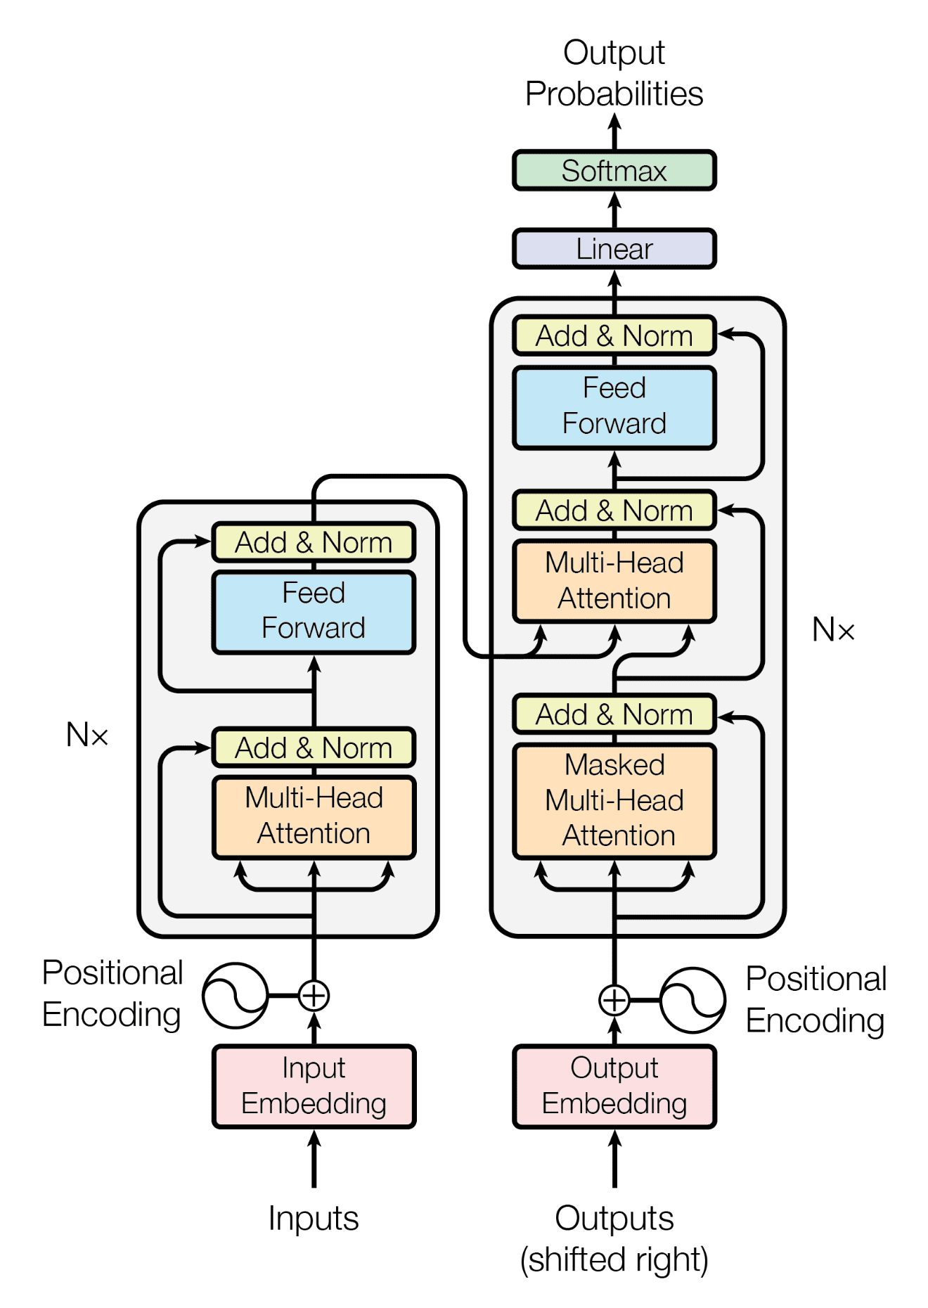
How Transformers Work?
It was first proposed by [14] as a sequence-to-sequence model, for machine translation.
Transformer architectures rely on attention mechanisms to encode and decode sequential data.
Transformer, or attention mechanism, can’t inherently capture positional information (like RNNs). Hence, a positional encoding is embedded into input embeddings to incorporate positional information of entities (tokens) in the sequence.
Implements multi-head attention i.e. more than one attention that allows the model to jointly attend to information from different representation subspaces at different positions.
Transformer Model [14]

Slide 9
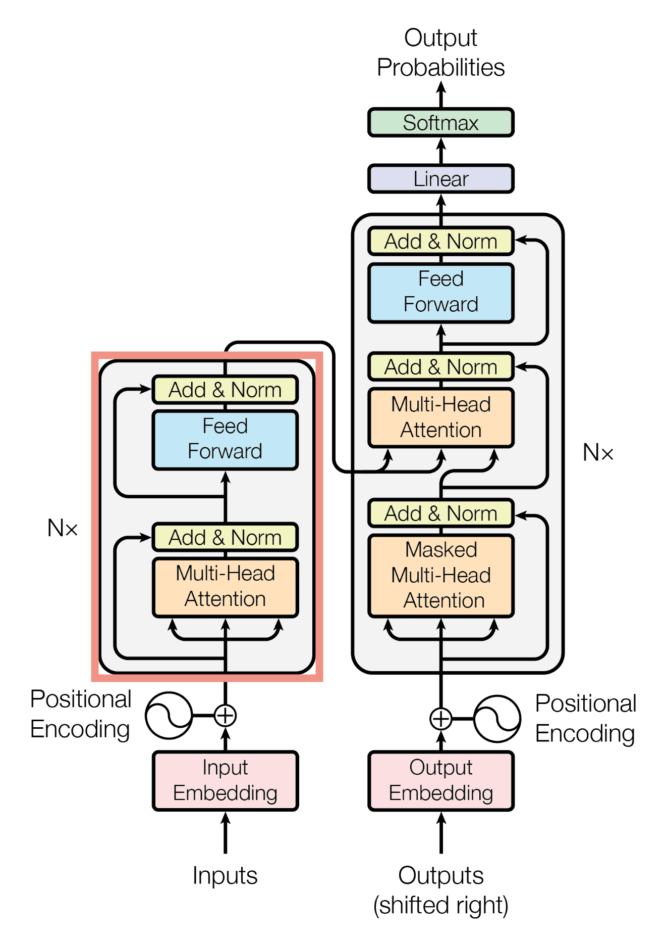
The Encoder
Implements Self-Attention.
The encoder processes the whole input text (tokenized) at once.
Bidirectional
Learns language representation, syntax, and semantics.
Encoder Only Transformer BERT [17]

Slide 10
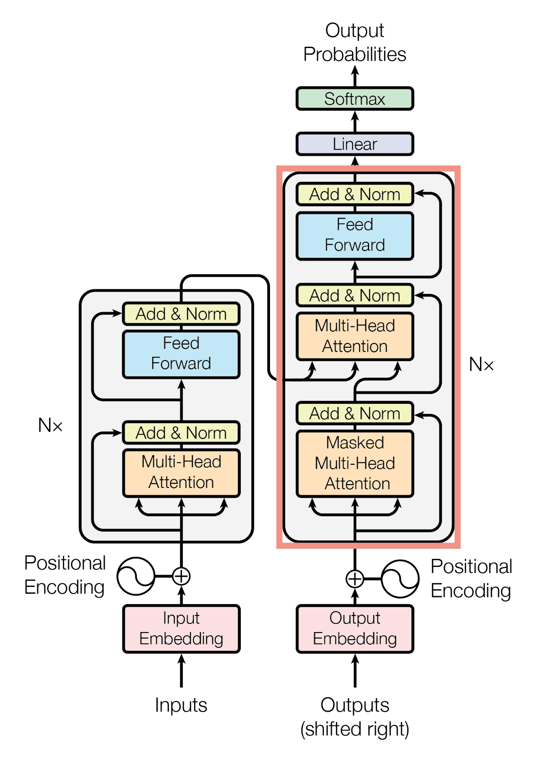
The Decoder
Implements Causal Self-Attention and Cross-Attention.
It is sequential and processes each token one after another.
Unidirectional (Left to Right)
Learns language representation, syntax, and semantics
Generates language based on previously seen tokens.
Decoder-only transformer GPT [18]

Slide 11
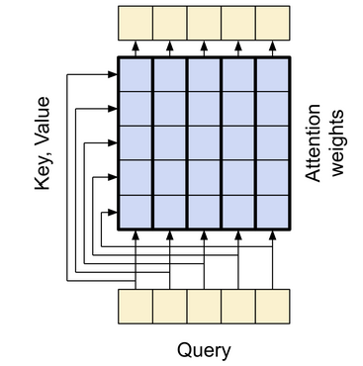
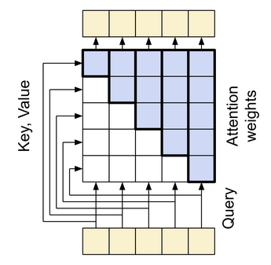
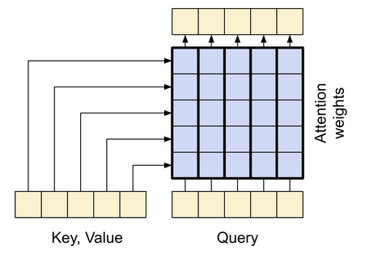
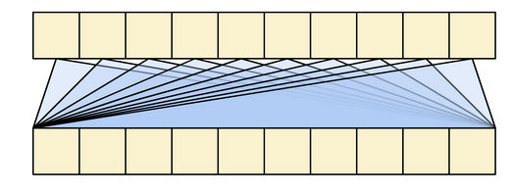
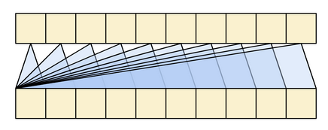
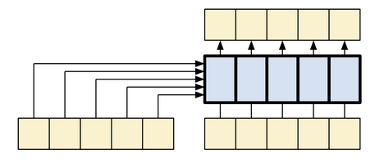
Attention Mechanism
(i) Global Self-Attention (ii) Causal Self-Attention (iii) Cross Attention [25]

Slide 12
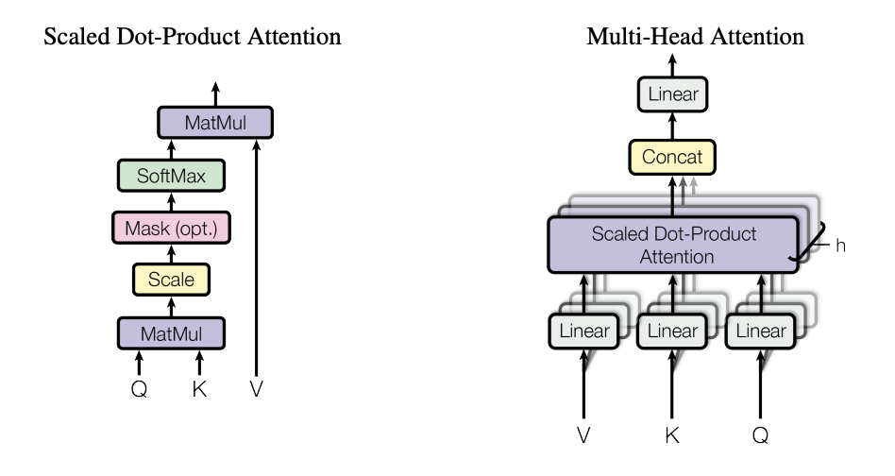







Attention Mechanism
$$Attention(Q, K, V ) = softmax(\frac{QK^{T}}{\sqrt{d_{k}}})V$$
here,
$Q = X ∗ W_{Q}$
$K = X ∗ W_{K}$
$V = X ∗ W_{V}$
where,
‘X’ is the input (embedding) sequence and W_{Q}, W_{K,} and W_{V} are learnable weights for, Q(query), K(key), and V(value), respectively
‘h ’ is the number of attention heads.
d_{k} = d_{v} = d_{model}/h . The d_{model} is a vector returned by the encoder/decoder block.

Slide 13
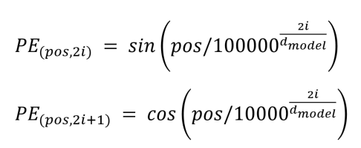
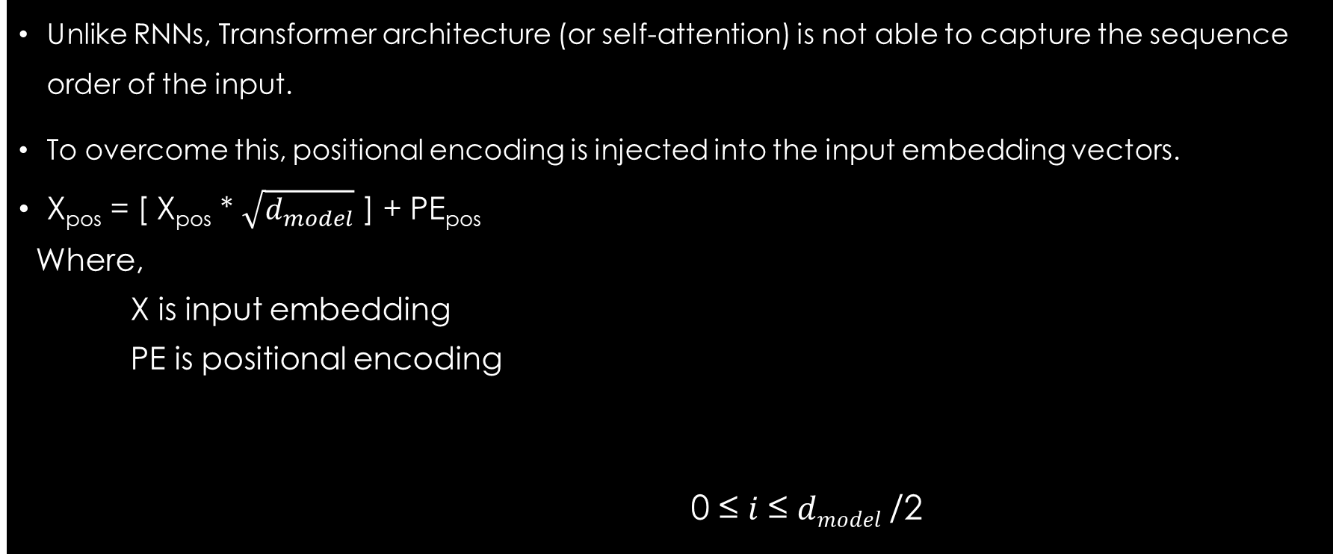
Positional Encoding
Unlike RNNs, Transformer architecture (or self-attention) is not able to capture the sequence order of the input.
To overcome this, positional encoding is injected into the input embedding vectors.
X_{pos} = [ X_{pos} * $\sqrt{d_{model}}$ ] + PE_{pos}
Where,
X is input embedding
PE is positional encoding
0 ≤ 𝑖 ≤ 𝑑_{𝑚𝑜𝑑𝑒𝑙} /2

Slide 14
Literature Review
Most of the works on Sentiment Analysis of Nepali texts are based on ML-based approaches (mostly SVM and others) and Deep learning-based approaches (RNN’s and CNN’s) [4][5][6][7][8][10][25].
There are not many works related to Sentiment Analysis using Transformer models. Only one work was found, that reports the performance of Multilingual-BERT compared to BiLSTM, CNN, and SVM [5].
Some works have been done in news classification using transformer models. All of those works show that one or the other BERT-based models perform better than ML-based (SVM, RF, etc.) approaches and other deep learning approaches [11][26][27][28].

Slide 15
Literature Review
Only 2 Nepali only Pre-trained BERT Language Models (LM) are available, namely NepaliBERT and NepBERTa [9][10]. Other than that, there is one distilBERT and one DeBERTa model[11]. There are some cross-lingual BERT-based models that support Nepali language, like Multilingual BERT [17] and XLM-RoBERTa [24].
There are no known Nepali-only Pre-Trained GPT-based LMs available . Thus, there hasn’t been any work done on SA with a GPT model on Nepali texts.
The previous benchmark for this study (as per dataset used) is given by [6][7][8].

Slide 16
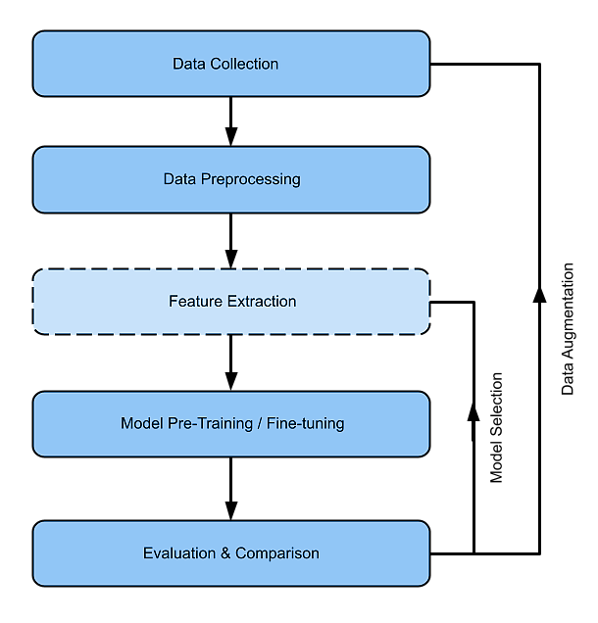
Research Methodology - Workflow
The research in this study is conducted in an iterative process of data collection and preprocessing, model selection and training, and performance evaluation and comparison

Slide 17
Research Methodology Data Collection
Data Collection:
NepCov19Tweets [6] : a collection of tweets from Twitter regarding Covid-19.
NepCov19TweetsPlus: NepCov19Tweets after data augmentation.
A collection of texts from Twitter regarding Nepal Earthquake 2015.
20GB of Nepali text corpora for language model training: NepBERTa corpus, Oscar corpus, CC-100, Wikipedia, News dataset, and other scraped Nepali texts.

Slide 18
Research Methodology Data augmentation
Covid-19 related news headlines were scraped from News portals.
A fine-tuned model is used to classify the news headlines to positive, negative and neutral. The neutral ones are then selected.
From the selected headlines, any headline with words giving negative sentiments were removed (like death).
After that, visually (manually) inspected and finalized.

Slide 19
Research Methodology NepCov19Tweets Dataset
Positive
Positive
Negative
Negative
Neutral
Neutral
Before Augmentation
After augmentation

Slide 20
Research Methodology Model Architecture
Data Preprocessing:
Cleaning & Tokenization
Model Architecture:
Bert-based models → nepaliBERT [9], NepBERTa [10], distilBERT (say NepDistilBERT) and DeBERTa (say NepDeBERTa) [11], multilingual BERT [17], XLM-RoBERTa [24] and distilBERT-Nepali *.
GPT-based models → GNePT * and distilGPT-Nepali *
Hybrid Model → SVM and MLP

Slide 21
Research Methodology Pre-training and Fine-tuning
Pre-training and Fine-Tuning:
distilBERT-Nepali, a model pre-trained on 6GB of Nepali text data.
GNePT, a model pre-trained on 20GB of Nepali text data.
distilGPT-Nepali, a model pre-trained on 20GB of Nepali text data.
All the selected models are fine-tuned on NepCov19Tweets and NepCov19TweetsPlus dataset as well as NepaliTweets dataset.

Slide 22

Research Methodology Evaluation
Evaluation:
Performance evaluation of the fine-tuned models will be done using evaluation metrics like F1-score, accuracy, precision and recall.
Given a confusion matrix as shown in the figure,
Accuracy = $\frac{TP + TN}{TP + FP + TN + FN}$
Precision = $\frac{TP}{TP + FP}$
Recall = $\frac{TP}{TP + FN}$
F1 score = $2×\frac{Precision ×Recall}{Precision+Recall}$

Slide 23
Implementation Tools, platforms and libraries
Python3 programming language
Huggingface’s transformers, datasets and tokenizers library.
Transformers library with Tensorflow backend.
Scikit-learn for SVM and performance metrics.
Tensorflow for MLP, confusion matrix
Matplotlib and Seaborn for visualization
Huggingface-Hub and Kaggle datasets as data repositories
Computing platforms: Personal laptop, Kaggle notebook, and Colab notebook

Slide 24
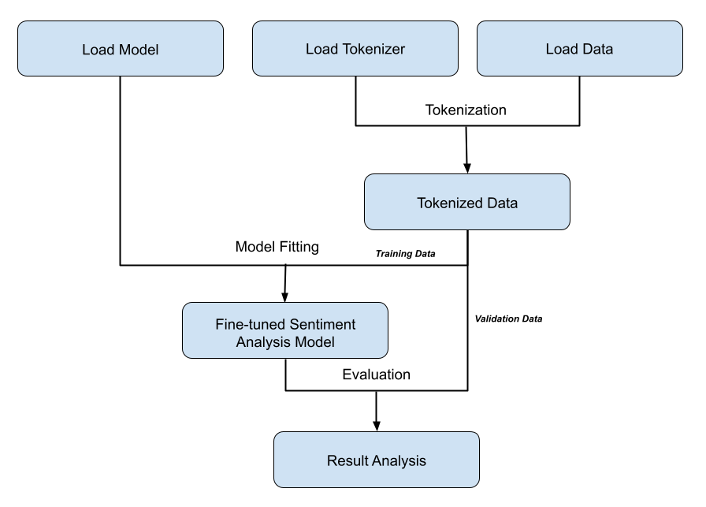
Implementation Details
Tokenizer and Dataset loading
Tokenization
Model loading and hyper-parameter tuning
Model fitting
Evaluation
Fig. Model training workflow

Slide 25
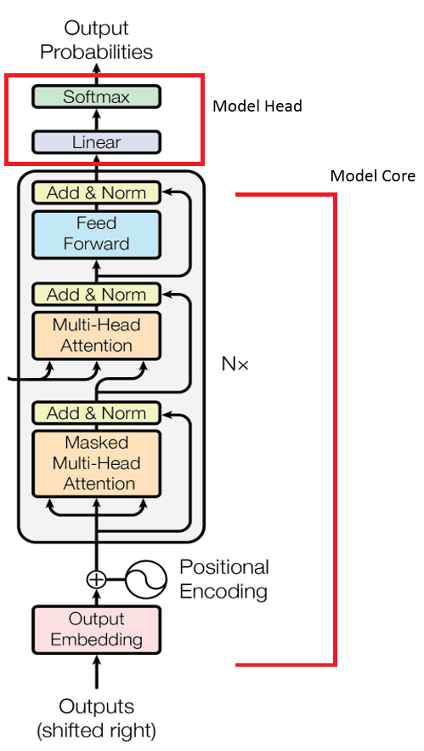
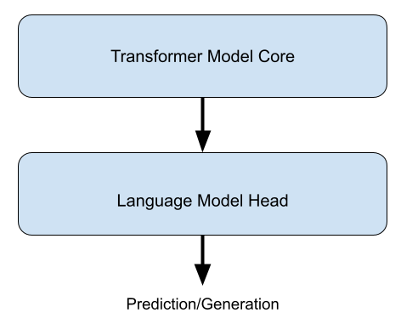
Implementation Model Organization
Language Model

Slide 26
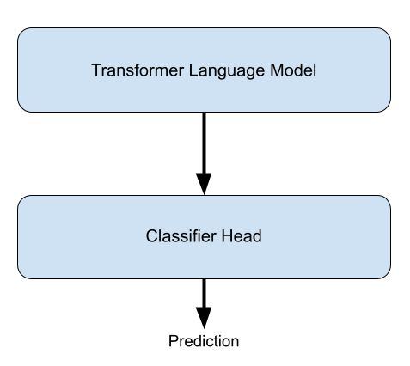
Implementation SA Model Organization
Transformer Language Model is one of the transformer models.
Classifier head is
A neural network layer
SVM model
MLP model

Slide 27
Implementation Hyper-parameters
The hyper-parameters that are subject to fine-tuning in this study are
Number of Epochs
Training / Validation Batch Size
Optimization parameters
Learning rate
Weight decay rate
Every other parameters that could be tuned, like internal parameters of BERT and other language models used, weren’t changed and the default settings provided by the libraries were used.

Slide 28
Training / Validation loss graph during fine-tuning of models on NepCov19Tweets dataset.
Here, number of epochs each model was trained for can be seen.

Slide 29
Training – Validation split of Dataset
The ratio used for training set and validation set is 80:20.
The validation split is generated by selecting approximately 20% of data from each class and remaining is used for training set.

Slide 30
Hybrid Model workflow
Hybrid model is a sort of a pipeline than a single model, where transformer model and end-classifier works in tandem for the task of sentiment analsysis.
Context feature vectors of texts are extracted using transformer model and the extracted context feature vectors are then used to train the end-classifier and to make inference.
The transformer models used for feature extraction are a fine-tuned model rather than just a language model.
In case of GPT-based models, instead of using last token output as the feature, a trailing contexts of last 2 tokens were used. Then a single feature is obtained by using a pooling function.

Slide 31
Result Analysis SA on NepCov19Tweets dataset
 | Precision | Recall | Accuracy | F1-score
nepaliBERT | 0.7311 | 0.7421 | 0.7421 | 0.7277
NepBERTa | 0.7553 | 0.7607 | 0.7607 | 0.7573
DistilBERT-Nepali * | 0.7579 | 0.7657 | 0.7657 | 0.7587
NepDeBERTa | 0.7624 | 0.7671 | 0.7671 | 0.7645
NepDistilBERT | 0.7546 | 0.7544 | 0.7544 | 0.7543
M-BERT | 0.73.55 | 0.7422 | 0.7422 | 0.7309
XLM-RoBERTa | 0.7536 | 0.7620 | 0.7620 | 0.7488
GNePT * | 0.6787 | 0.6920 | 0.6920 | 0.6826
DistilGPT-Nepali * | 0.6824 | 0.6947 | 0.6947 | 0.6857

Slide 32
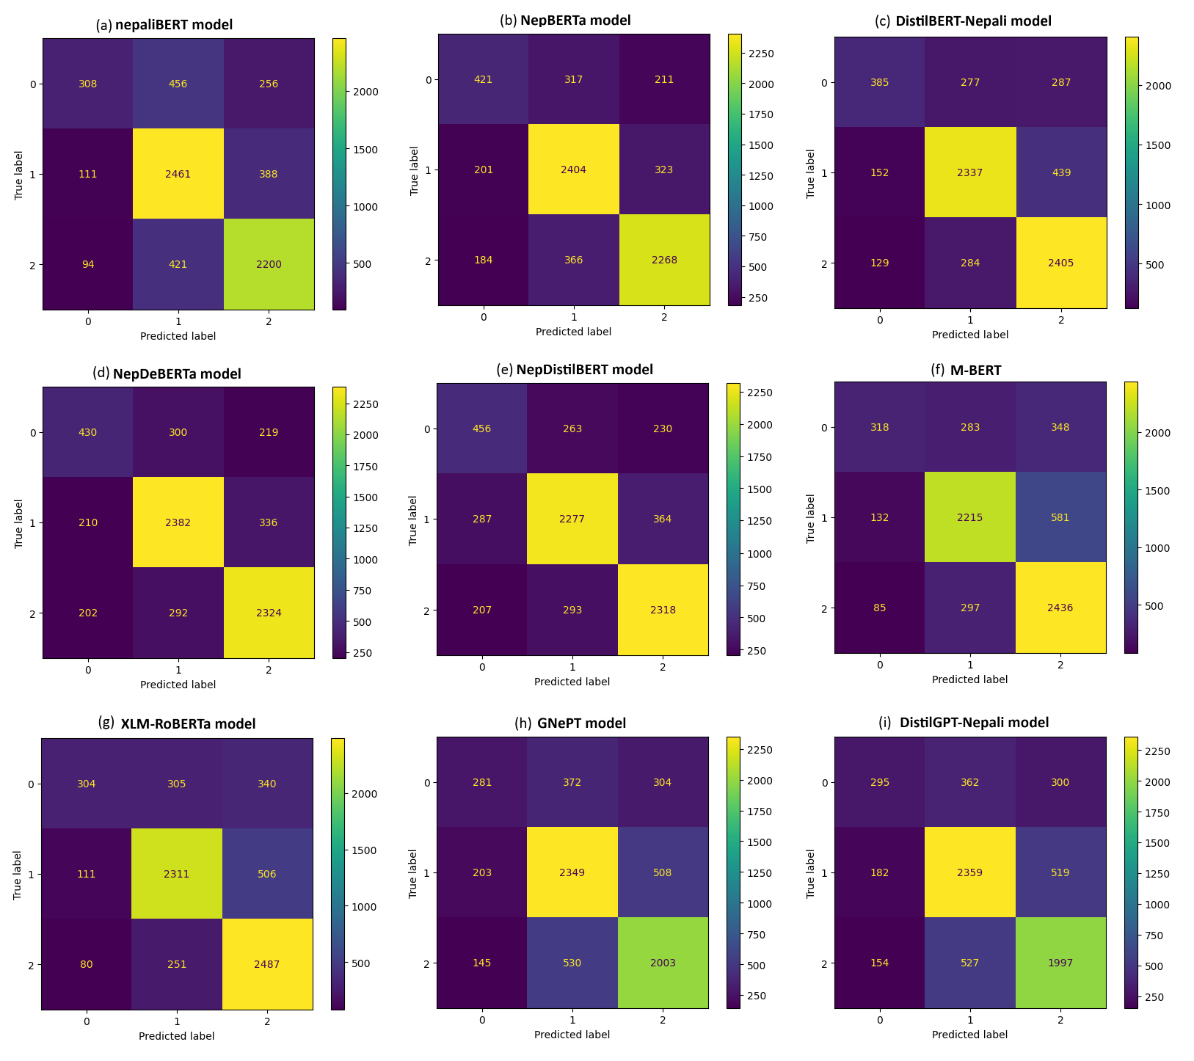
Result Analysis SA on NepCov19Tweets dataset
Confusion matrix
Models fail at identifying neutral class.
Not even 50% recall.

Slide 33
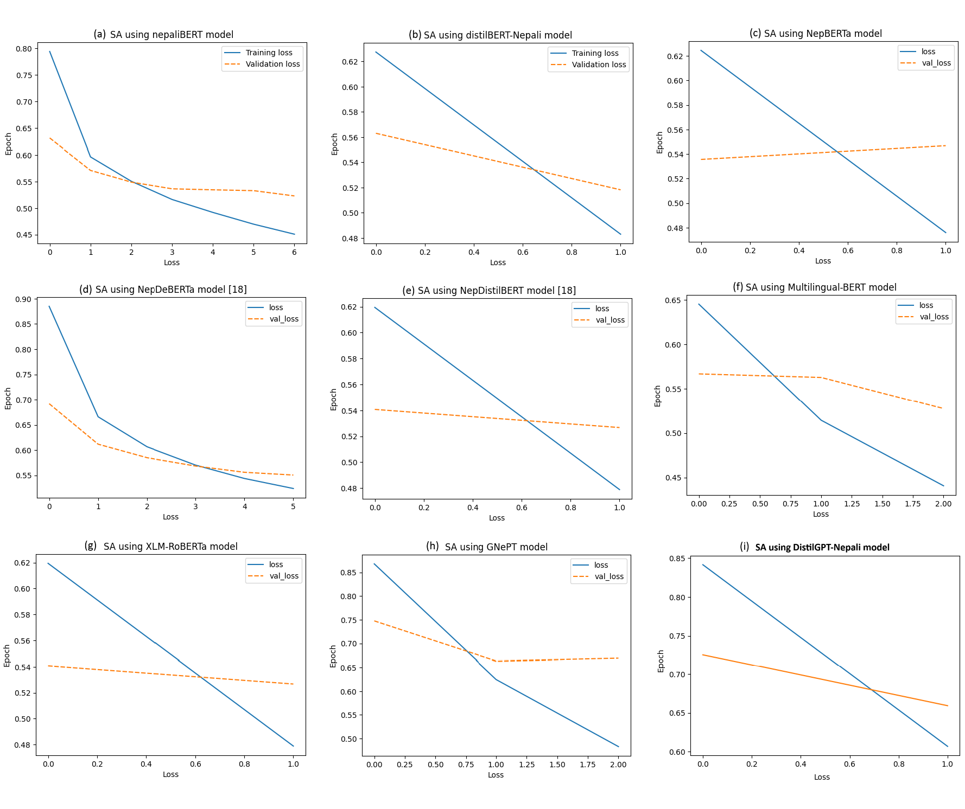
Result Analysis SA on NepCov19TweetsPlus dataset
Training / Validation loss graph during fine-tuning of models on NepCov19Tweets dataset.

Slide 34
Result Analysis SA on NepCov19TweetsPlus dataset
 | Precision | Recall | Accuracy | F1-score
nepaliBERT | 0.8022 | 0.7973 | 0.7973 | 0.7975
NepBERTa | 0.7901 | 0.7879 | 0.7879 | 0.7879
DistilBERT-Nepali * | 0.7995 | 0.7889 | 0.7889 | 0.7889
NepDeBERTa | 0.8003 | 0.7853 | 0.7853 | 0.7844
NepDistilBERT | 0.7869 | 0.7866 | 0.7866 | 0.7866
M-BERT | 0.7802 | 0.77987 | 0.77987 | 0.77998
XLM-RoBERTa | 0.7864 | 0.7846 | 0.7846 | 0.7842
GNePT * | 0.7306 | 0.7244 | 0.7244 | 0.7247
DistilGPT-Nepali * | 0.7235 | 0.7078 | 0.7078 | 0.7069

Slide 35
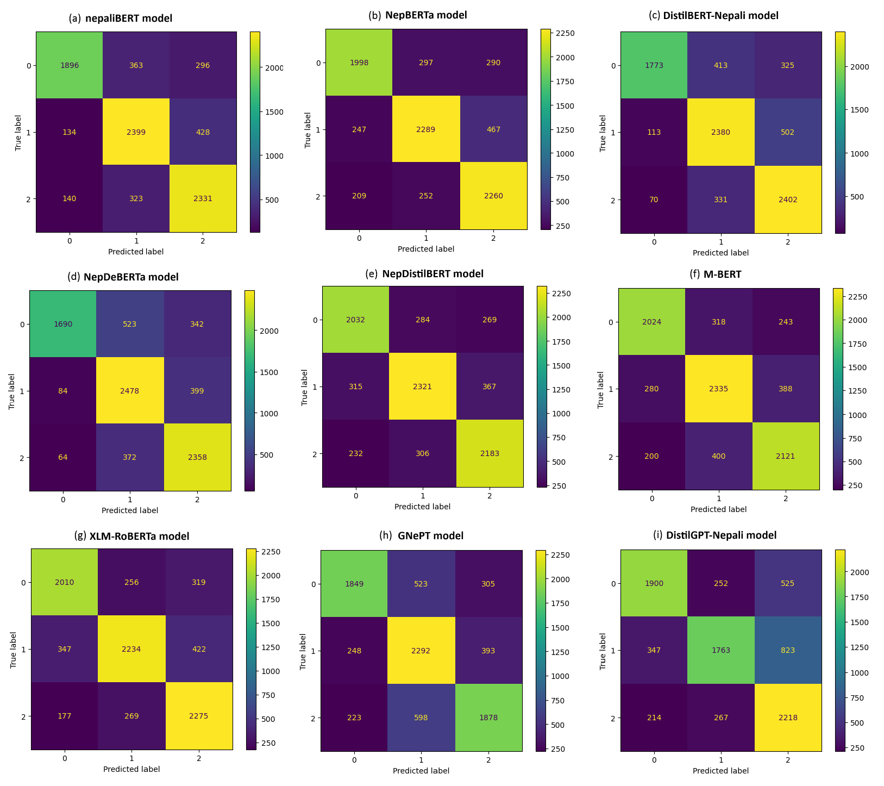
Result Analysis SA on NepCov19TweetsPlus dataset
The overall performance of model increased after data augmentation

Slide 36
Result Analysis SA using Hybrid Approach
 | Precision | Recall | Accuracy | F1-score
nepaliBERT+SVM | 0.8429 | 0.8389 | 0.8389 | 0.8393
nepaliBERT+MLP | 0.7965 | 0.7942 | 0.7942 | 0.7944
DistilBERT-Nepali + SVM | 0.8549 | 0.8523 | 0.8523 | 0.8522
DistilBERT-Nepali + MLP | 0.8497 | 0.8487 | 0.8487 | 0.8488
GNePT + SVM | 0.8281 | 0.8230 | 0.8230 | 0.8232
GNePT + MLP | 0.8248 | 0.8223 | 0.8223 | 0.8226
DistilGPT-Nepali + SVM | 0.8195 | 0.8144 | 0.8144 | 0.8146
DistilGPT-Nepali + MLP | 0.8246 | 0.8206 | 0.8206 | 0.8208
Hybrid-Feature + SVM | 0.8563 | 0.8539 | 0.8539 | 0.8540
Hybrid-Feature + MLP | 0.8570 | 0.8565 | 0.8565 | 0.8566
distilHybrid-Feature + SVM | 0.8599 | 0.8581 | 0.8581 | 0.8582
distilHybrid-Feature + MLP | 0.8604 | 0.8595 | 0.8595 | 0.8596

Slide 37
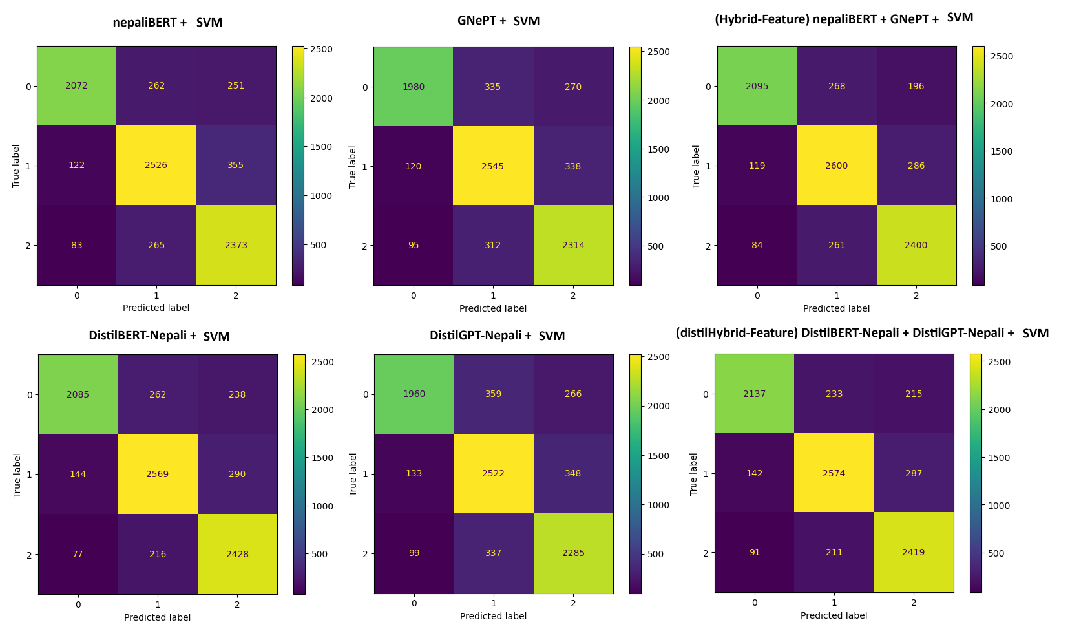
Result Analysis Hybrid approach with SVM
On single model context feature approach, distilBERT-Nepali model performed best with 85.23% accuracy and 85.22% F1score. This is the overall highest score achieved in this study.
Similary, on two model context feature approach, distilHybrid approach performed best with 85.81% accuracy and 85.82% F1score.

Slide 38
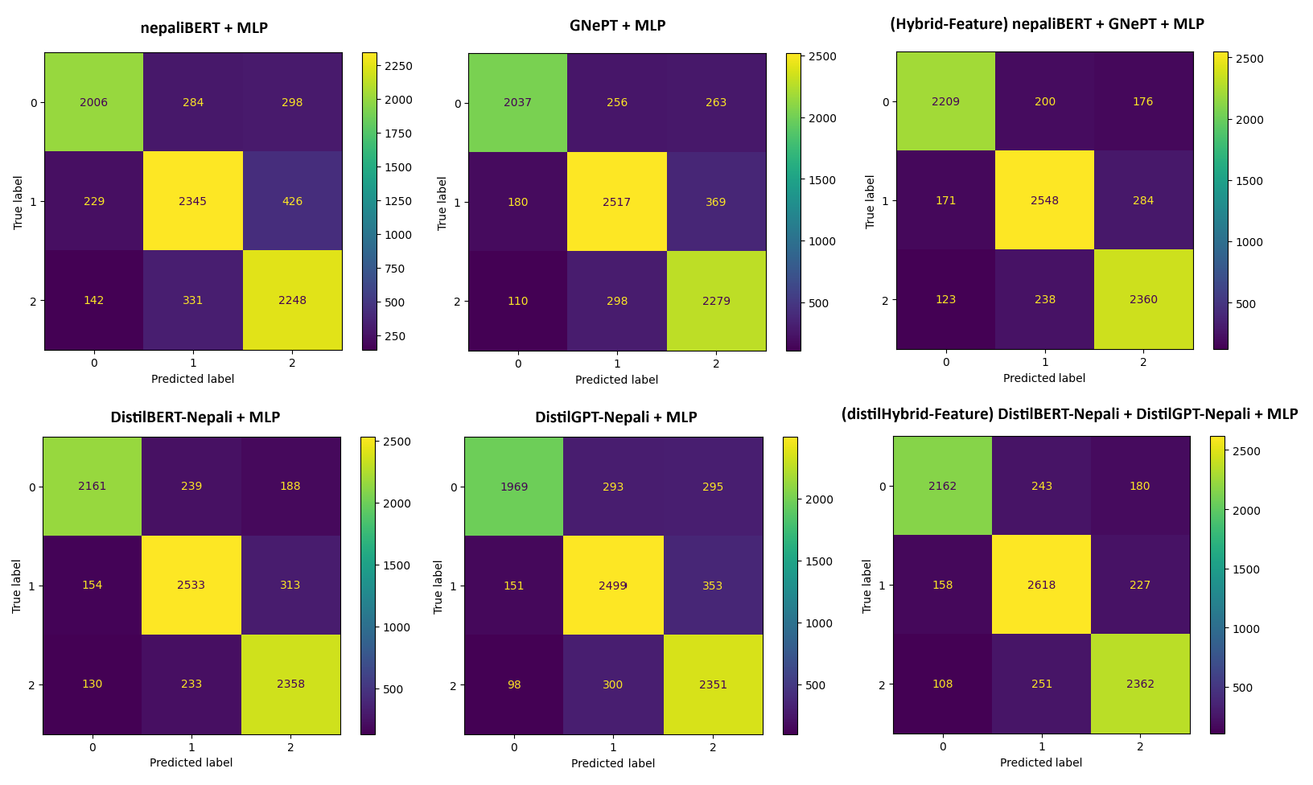
Result Analysis Hybrid approach with MLP
On single model context feature approach, distilBERT-Nepali model performed best with 84.87% accuracy and 84.88% F1score.
Similary, on two model context feature approach, distilHybrid approach performed best with 85.95% accuracy and 85.96% F1score. This is the overall highest score achieved in this study.

Slide 39
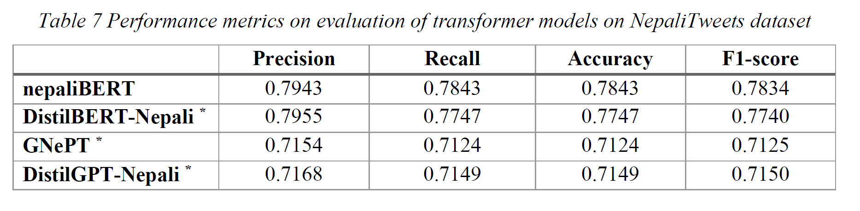
Result Analysis Domain adaptation and Nepali Tweets
News classification model (nepaliBERT) with 86% accuracy and 86.24% F1-score for news classification is fine-tuned for Sentiment analysis which achieved 79.59%accuracy 79.62% f1-score. There was no performance boost with domain adapatation.
Similarly, there was no performance boost with NepaliTweets dataset, but rather the models’ performance slightly decreased.

Slide 40
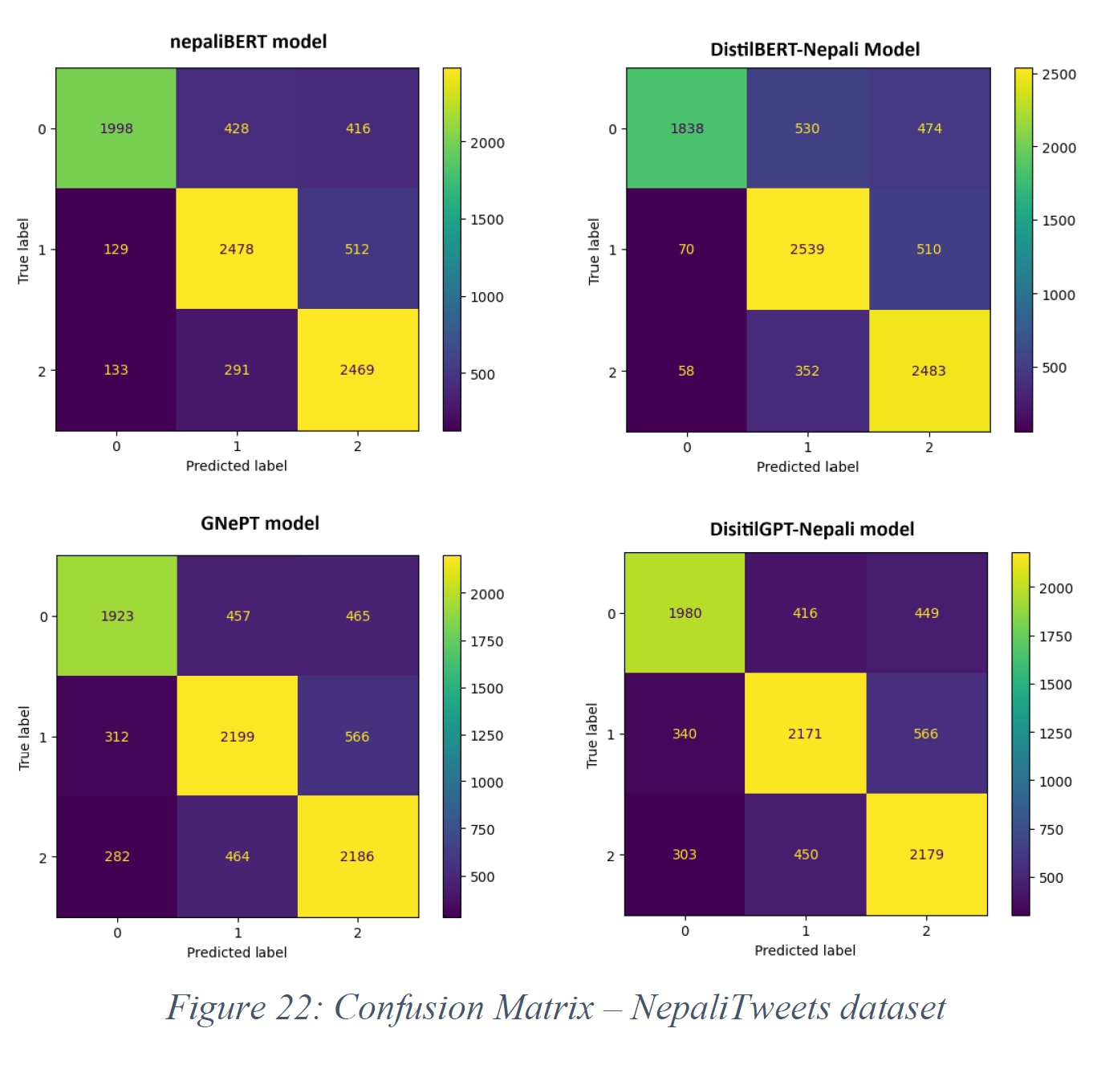
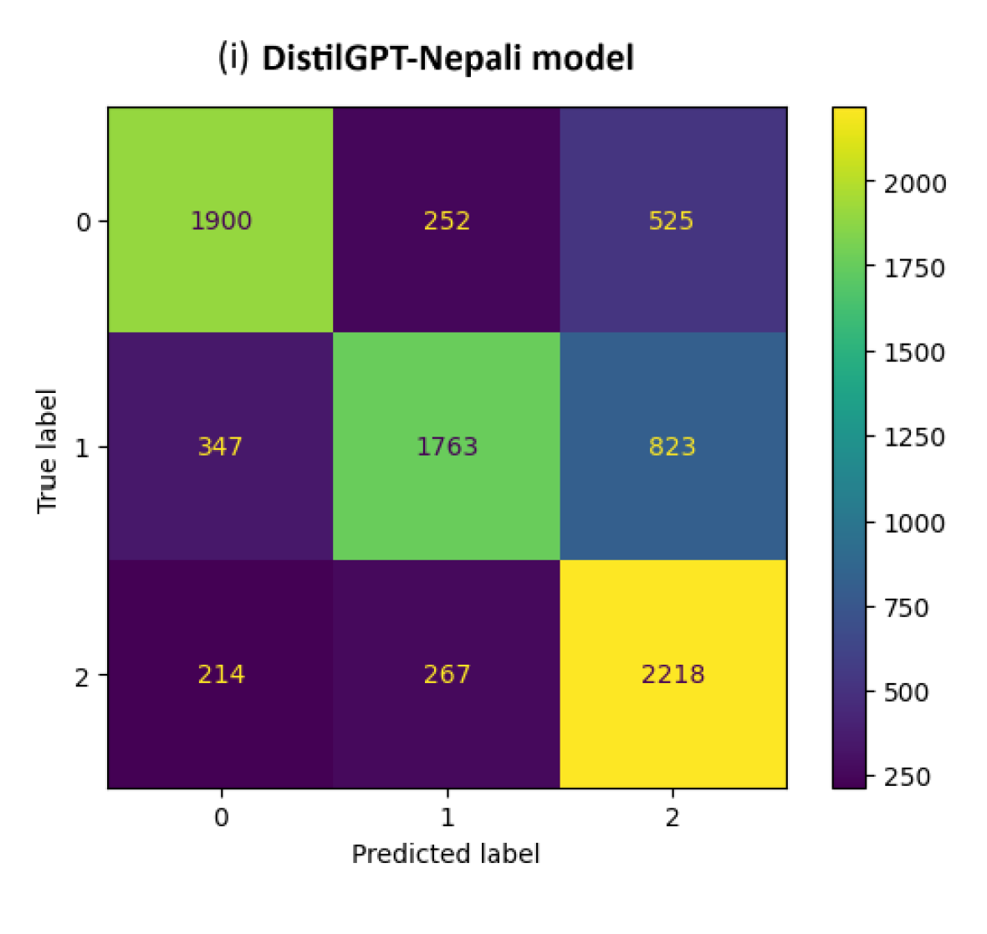
Result Analysis Nepali Tweets
Confusion matrix for NepCov19TweetsPlus

Slide 41
Conclusion
In general, BERT-based models perform better than GPT-based models for SA task.
With 76.71% accuracy and 76.45% F1score, DeBERTa model [11] outperformed other models for SA on NepCov19Tweets dataset.
Domain adaptation didn’t have any performance change.
Data-augmentation increased the model’s capacity. NepaliBERT model [9] gave the highest with 79.73% accuracy and 79.75% F1score.
The DistilBERT-Nepali with SVM achieved highest score in case of single transformer model hybrid approach, which is 85.23% accuracy and 85.22% F1score.

Slide 42
Conclusion
Using hybrid approach even further boost the model’s capacity on the task of Nepali SA. DistilBERT-Nepali + DistilGPT-Nepali + MLP model gave the highest with accuracy 85.95 and 85.96 F1score. DistilBERT-Nepali + DistilGPT-Nepali + SVM model was slightly behind with 85.81 accuracy and 85.82 F1score.
This study found that using a hybrid model approach drastically improved the performance of GPT-based models. For e.g. GNePT model’s accuracy on NepCov19Tweets dataset is 69.2% , 72.44% accuracy on NepCov19TweetsPlus dataset, and 82.3% accuracy with GNePT+SVM and 82.23% accuracy with GNePT+MLP.
Architectural similarity of using MLP model as end-classifier to adding a pooling layer to classifier head suggests that adding pooling layer to model that do not have it makes the model more robust on downstream task like SA.

Slide 43
Future Recommendation
More sentiment annotated Nepali social media texts i.e. collect more data
Implementing transformer model (BERT-based and GPT-based) with a extra pooling layer between language model and classification had.

Slide 44
References
[1] B. Liu, Sentiment Analysis: Mining Opinions, Sentiments, and Emotions, Cambridge University Press, 2015.
[2] T. B. Shahi and C. Sitaula, "Natural language processing for Nepali text: a review," Artificial Intelligence Review, Springer, vol. 55, pp. 3401-3429, 2021.
[3] R. Bommasani, D. A. Hudson, E. Adeli, R. Altman, S. Arora, S. v. Arx, M. S. Bernstein, J. Bohg, A. Bosselut, E. Brunskill, E. Brynjolfsson, S. Buch, D. Card, R. Castellon, N. Chatterji and others.., "On the Opportunities and Risks of Foundation Models," 2022.
[4] C. P. Gupta and B. K. Bal, "Detecting Sentiment in Nepali Texts: A Bootstrap Approach for Sentiment Analysis of texts in the Nepali Language".
[5] O. M. Singh, S. Timalsina, B. K. Bal and A. Joshi, "Aspect Based Abusive Sentiment Detection in Nepali Social Media Texts," in IEEE/ACM International Conference on Advances in Social Networks Analysis and Mining (ASONAM), 2020.

Slide 45
References
[6] C. Sitaula, A. Basnet, A. Mainali and T. B. Shahi, "Deep Learning-Based Methods for Sentiment Analysis on Nepali COVID-19-Related Tweets," Computational Intelligence and Neuroscience, 2021.
[7] T. B. Shahi, C. Sitaula and N. Paudel, "A Hybrid Feature Extraction Method for Nepali COVID-19-Related Tweets Classification".
[8] C. Sitaula and T. B. Shahi, "Multi-channel CNN to classify Nepali Covid-19 related tweets," 2022.
[9] S. Pudasaini, A. Tamang, S. Lamichhane, S. Adhikari, S. Adhikari, S. Thapa and J. Karki, "Pre-training of Masked Language Model in Nepali," in 36th Conference on Neural Information Processing Systems, 2022.
[10] M. Gautam, S. Timalsina and B. Bhattarai, "NepBERTa: Nepali Language Model Trained in a Large Corpus," in Proceedings of the 2nd Conference of the Asia-Pacific Chapter of the Association for Computational Linguistics and the, 2022.

Slide 46
References
[11] U. Maskey, M. Bhatta, S. R. Bhatta, S. Dhungel and B. K. Bal, "Nepali Encoder Transformers: An Analysis of Auto Encoding Transformer Language Models for Nepali Text Classification," in Proceedings of SIGUL2022 @LREC2022, 2022.
[12] S. Suwanchai, S. R. Tamrakar and Chaklam, "Comparative Evaluation of Transformer-Based Nepali Language Models," [Online]. Available: https://assets.researchsquare.com/files/rs-2289743/v1/aa3f3ba4a38a880db3d6c5dc.pdf?c=1670229384. [Accessed 19 06 2023].
[13] V. Sanh, L. Debut, J. Chaumond and T. Wolf, "DistilBERT, a distilled version of BERT: smaller, faster, cheaper and lighter," in Conference on Empirical Methods in Natural Language Processing (EMNLP), 2020.
[14] A. Vaswani, N. Shazeer, N. Parmar, J. Uszkoreit, L. Jones, N. A. Gomez, L. Kaiser and I. Polosukhin, "Attention Is All You Need," in 31st Conference on Neural Information Processing Systems (NIPS 2017), Long Beach, CA, USA, 2017.
[15] D. Bahdanau, K. Cho and Y. Bengio, "NEURAL MACHINE TRANSLATION BY JOINTLY LEARNING TO ALIGN AND TRANSLATE," in ICLR , 2015.

Slide 47
References
[16] Huggingface, "How do Transformers work?," Huggingface, [Online]. Available: https://huggingface.co/learn/nlp-course/chapter1/4. [Accessed 27 8 2023].
[17] J. Devlin, M.-W. Chang, K. Lee and K. Toutanova, "BERT: Pre-training of Deep Bidirectional Transformers for Language Understanding," Google AI Language, 2019.
[18] A. Radford and K. Narasimhan, "Improving Language Understanding by Generative Pre-Training," 2018.
[19] A. Radford, J. Wu, R. Child, D. Luan, D. Amodei and I. Sutskever, "Language Models are Unsupervised Multitask Learners".
[20] T. B. Brown, B. Mann, N. Ryder, M. Subbiah, J. Kaplan, P. Dhariwal, A. Neelakantan, P. Shyam, G. Sastry, A. Askell, S. Agarwal, A. Herbert-Voss, G. Krueger, T. Henighan, R. Child, A. Ramesh and Dani, "Language Models are Few-Shot Learners," Open AI, 2020.

Slide 48
References
[21] "Neural Machine Translation with a Transformer and Keras," Tensorflow, 03 06 2023. [Online]. Available: https://www.tensorflow.org/text/tutorials/transformer. [Accessed 24 06 2023].
[22] Y. Liu, M. Ott, N. Goyal, J. Du, M. Joshi, D. Chen, O. Levy, M. Lewis, L. Zettlemoyer and V. Stoyanov, "RoBERTa: A Robustly Optimized BERT Pretraining Approach," 26 7 2019. [Online]. Available: https://arxiv.org/pdf/1907.11692.pdf. [Accessed 23 06 2023].
[23] P. He, X. Liu, J. Gao and W. Chen, "DeBERTa: Decoding-enhanced BERT with Disentangled Attention," in ICLR , 2021.
[24] A. Conneau, K. Khandelwal, N. Goyal, V. Chaudhary, G. Wenzek, F. Guzmán, E. Grave, M. Ott, L. Zettlemoyer and V. Stoyanov, "Unsupervised Cross-lingual Representation Learning at Scale," arXiv, 2019.
[25] R. Piryani, B. Piryani, V. K. Singh and D. Pinto, "Sentiment analysis in Nepali: Exploring machine learning and lexicon-based approaches," Journal of Intelligent & Fuzzy Systems, p. 1–12, 2020.

Slide 49
References
[26] K. Kafle, D. Sharma, A. Subedi and A. K. Timalsina, "Improving Nepali Document Classification by Neural Network," in Proceedings of IOE Graduate Conference, 2016.
[27] T. B. Shahi and A. K. Pant, "Nepali News Classification using Naive Bayes, Support Vector Machines and Neural Networks," in International Conference on Communication, Information & Computing Technology (ICCICT), Mumbai, 2018.
[28] O. M. Singh, "Nepali Multi-Class Text Classification," 2018. [Online]. Available: https://oya163.github.io/assets/resume/Nepali_Text_Classification.pdf. [Accessed 19 6 2023].
[29] S. M. Mohammad, "A Practical Guide to Sentiment Annotation: Challenges and Solutions," in Proceedings of NAACL-HLT 2016, San Diego, California, 2016.
[30] P. J. O. Su'arez, B. S. Romary and L. Romary, "A Monolingual Approach to Contextualized Word Embeddings for Mid-Resource Languages," in Proceedings of the 58th Annual Meeting of the Association for Computational Linguistics, 2020.
[31] N. Cristianini and J. Shawe-Taylor, An Introduction to Support Vector Machines and Other Kernel- based Learning Methods, Cambridge University Press, 2002.

Slide 50
Sentiment Analysis Of Social Media Texts In Using Transformers
g]kfnL
A Dissertation Report
By Regan Maharjan
Roll no. 17/75

